Slide 1
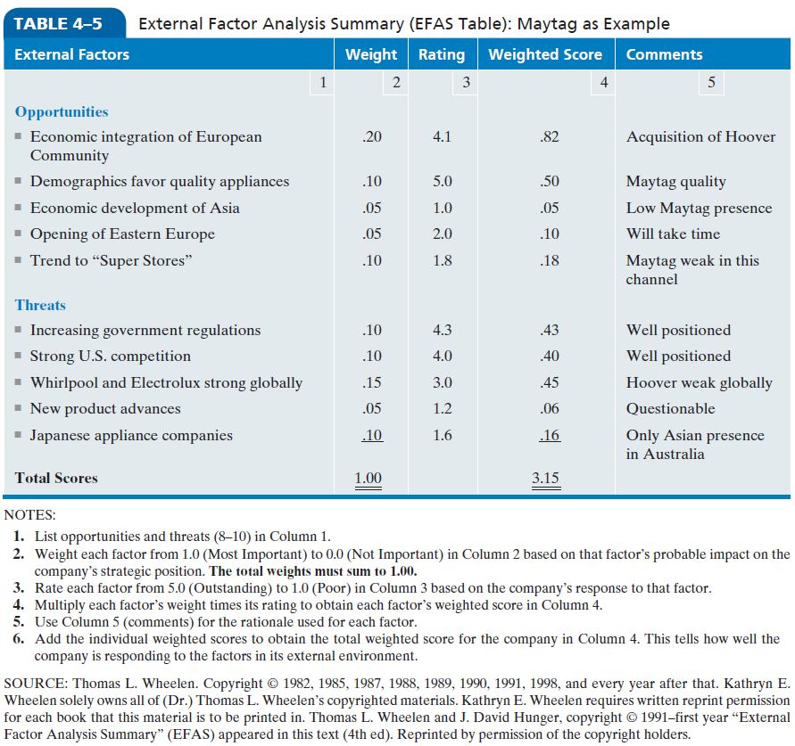
Table 4-5: Synthesis of External Factors—EFAS
Notes:
After strategic managers have scanned the natural, societal, and task environments and identified a number of likely external factors for their particular corporation, they may want to refine their analysis of these factors by using a form such as that given in Table 4–5.
As an example of this procedure, Table 4–5 includes a number of external factors for Maytag Corporation with corresponding weights, ratings, and weighted scores provided. This table is appropriate for 1995, long before Maytag was acquired by Whirlpool. Note that Maytag’s total weight was 3.15, meaning that the corporation was slightly above average in the major home appliance industry at that time.

Slide 2
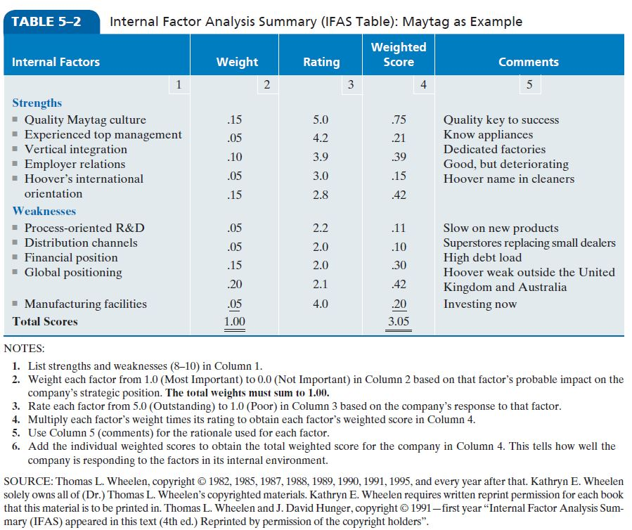
Table 5-2: Synthesis of Internal Factors (IFAS)
Notes:
Use the VRIO framework (Value, Rareness, Imitability, and Organization) to assess the importance of each of the factors that might be considered strengths.

Slide 3
TOWS Matrix

Slide 4
TOWS Matrix- illustrates how the external opportunities and threats can be matched with internal strengths and weaknesses to result in 4 possible strategic alternatives
Provides a means to brainstorm alternative strategies
Forces managers to create various kinds of growth and retrenchment strategies
Used to generate corporate as well as business strategies

Slide 5
